Slide 1
B.Tech Project
Indoor Localization using Bluetooth (BLE) Beacons
Team 12
Faculty Advisor – Dr. Venkata Ramana Badarla
Members – Abhishek Kaushik CS17B001
Nilesh Tiwari CS17B022

Slide 2
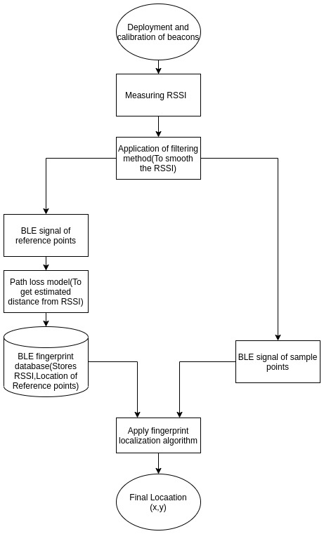
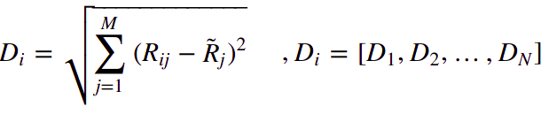
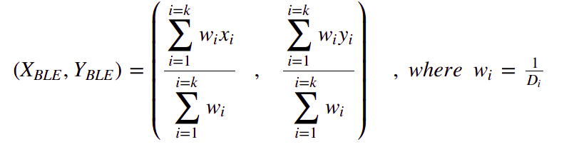
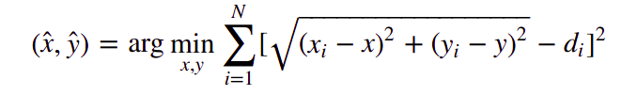
Introduction
Problem Statement - Given a user with a smartphone in an indoor space, determine its location.
Analyze the effect of localisation techniques on MAE for different environments, and determine
useful fingerprint dimensionality for different localisation techniques.
Area - Indoor Localization
Subarea - Range based indoor localization using fingerprinting method and BLE technology
Localisation Algorithms -
WKNN
NLLS
D_{i} is Euclidean distance between R_{ij} ( RSSI at ith reference point from jth beacon) and R̃j (RSSI at online point)
(X_{BLE} , Y_{BLE}) is final location.
where di is estimated distance, (x_{i} , y_{i}) is known positions of beacon and (x,y) final location has to be determined.
Fig.1 Flow diagram of project

Slide 3
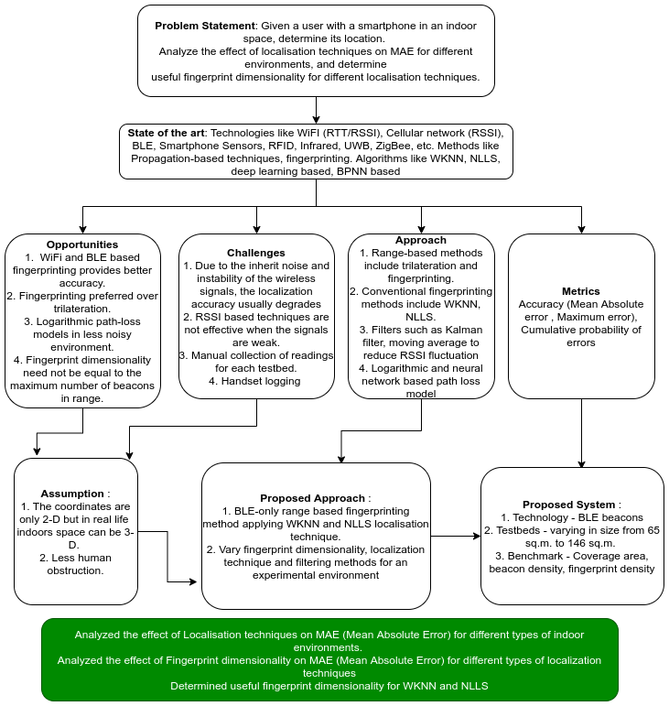
Concept Map

Slide 4
Objective
To create a indoor localization model using BLE (Bluetooth Low Energy) beacons with conventional localization techniques.
To get satisfactory MAE (Mean Absolute Error) for the different types of indoor environments.
To analyze the effect of Localisation techniques on MAE (Mean Absolute Error) for different types of indoor environments
To analyze the effect of Fingerprint dimensionality on MAE (Mean Absolute Error) for different types of localisation techniques
To determine useful fingerprint dimensionality for WKNN and NLLS

Slide 5
SWO Analysis
Strength
Determined the localisation technique out of NLLS and WKNN, suitable for different types of indoor environments. WKNN when path-loss component is high else NLLS.
Determined the variation of MAE with fingerprint dimensionality for localisation techniques NLLS and WKNN.
Determined the useful fingerprint dimensionality for localisation techniques NLLS and WKNN. Fingerprint dimensionality not equal to the maximum number of beacons for NLLS.
Weakness
Only conventional localisation techniques are used. The results are only useful for these two localisation techniques.
The model does not use correction of RSSI before filtering.
The model has not been tested over a highly variable environment that has high temporal instability.
Opportunities
The recent localisation techniques which include deep learning and neural network models can also be used to perform such a study.
Current model can be combined with technologies such as Wifi, light intensity. to build hybrid model.

Slide 6
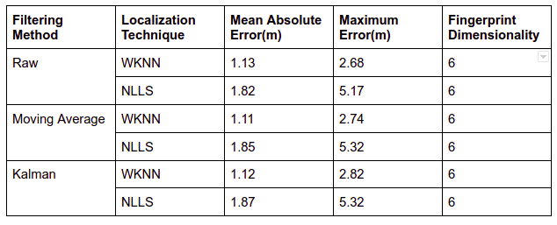
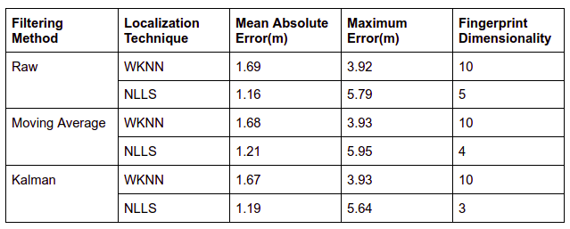
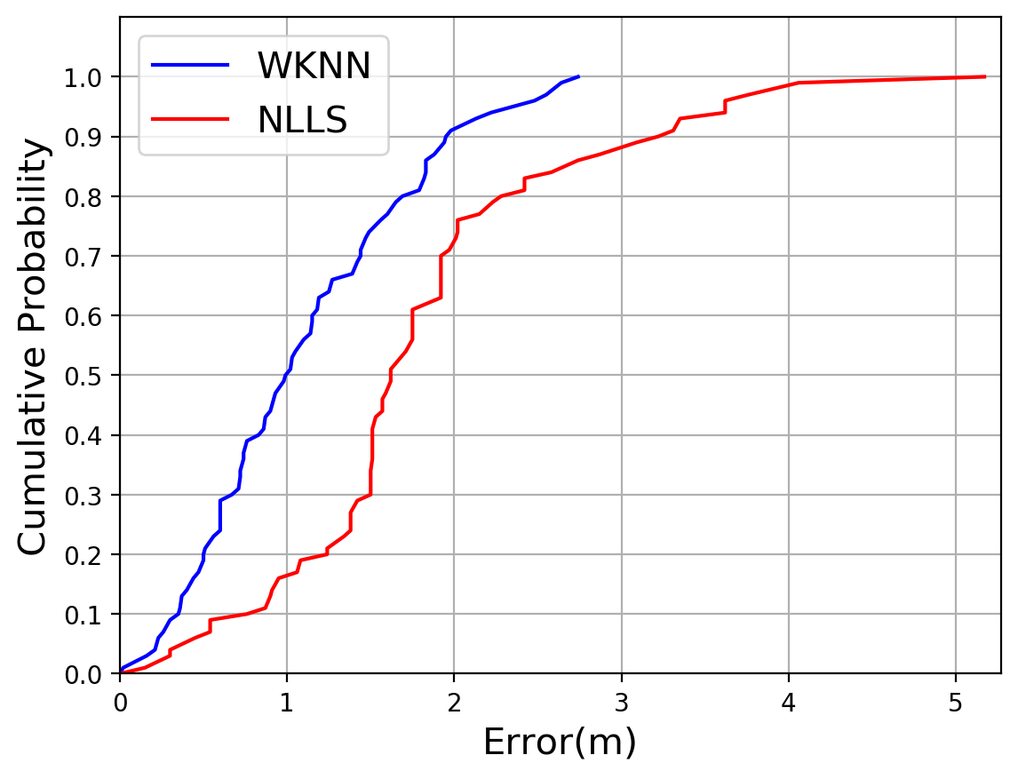
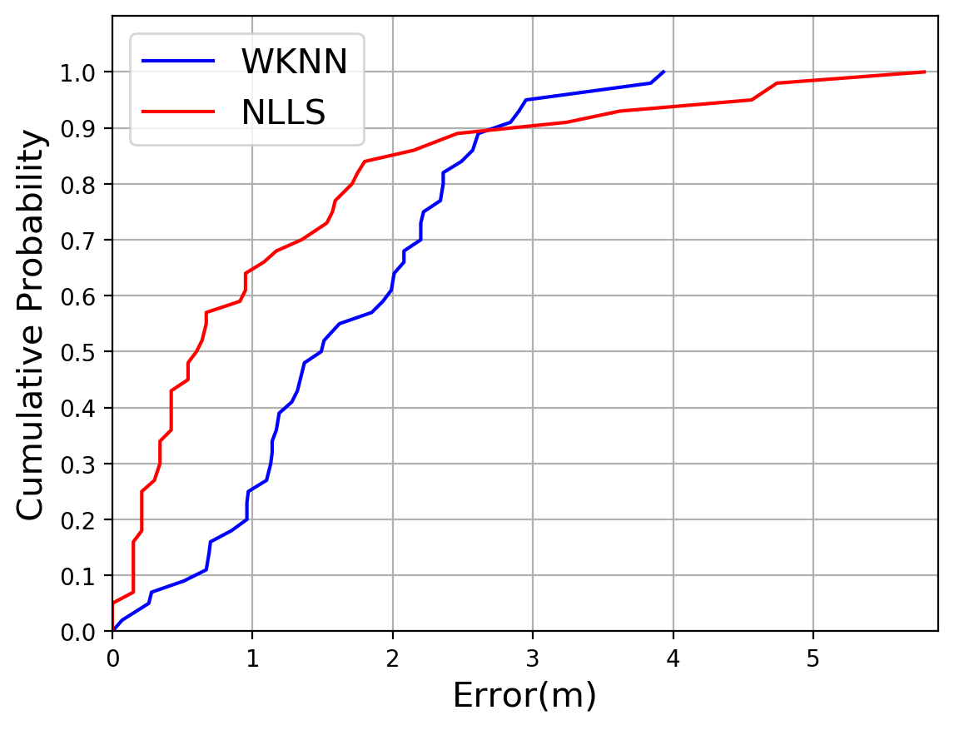
Evaluation of Results
We have evaluated our results on the basis of MAE and maximum error. Attached figures shows the best results obtained for corridor is 1.11m and for library is 1.16m..
Fig.2 Results for Corridor (36m x 1.8m)
Fig.3 Results for Library (17.4m x 8.4m)
Fig.4 Cumulative Probability of Error for corridor
Fig.5 Cumulative Probability of Error for library

Slide 7
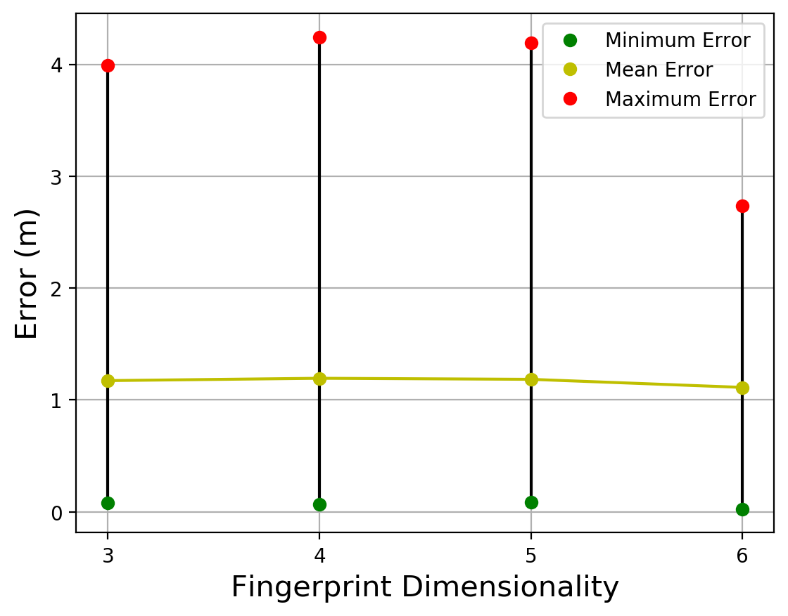
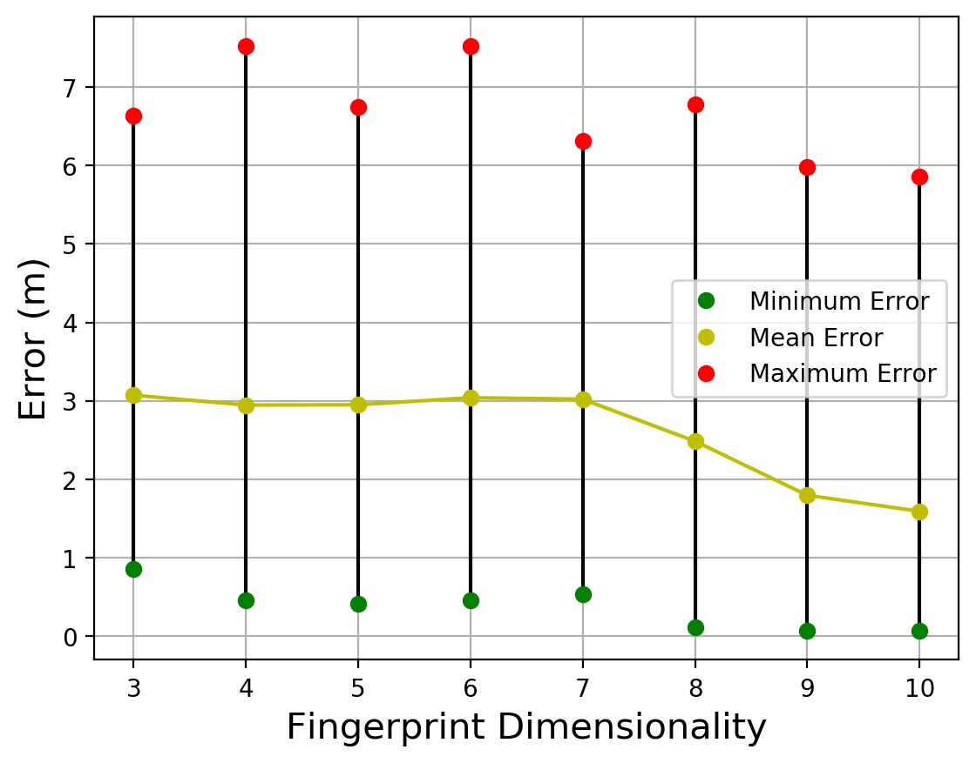
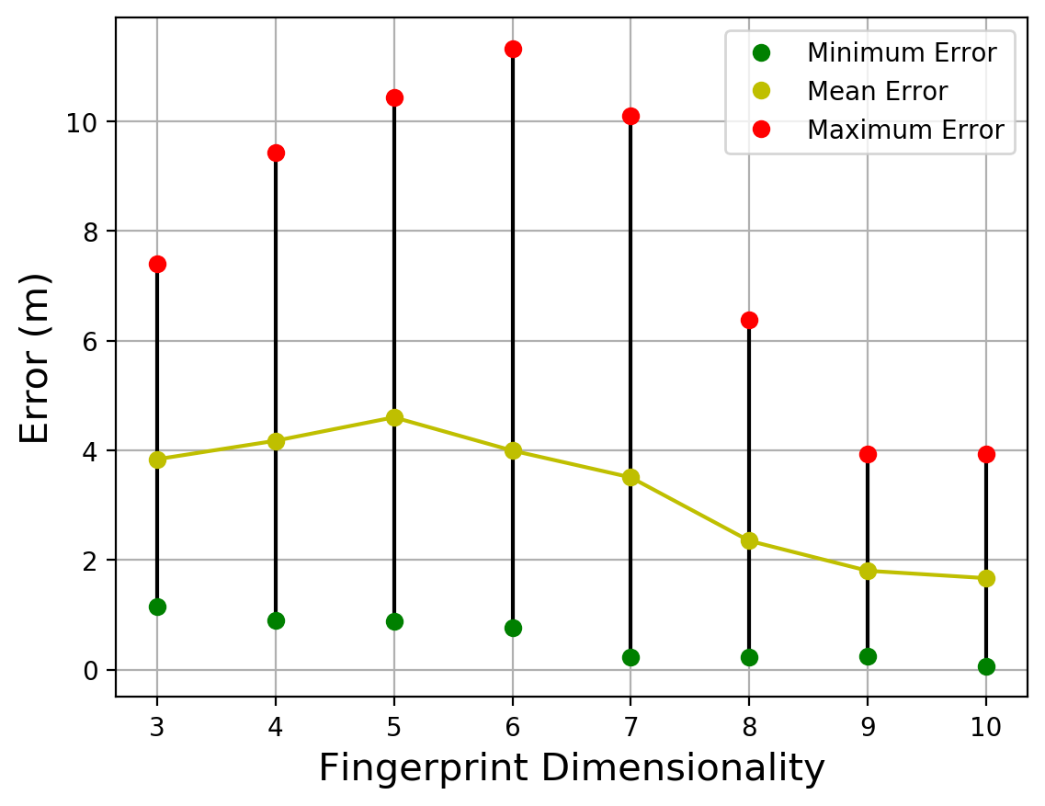
Evaluation Cont.
Variation of MAE for WKNN method for each of the testbeds
As the fingerprint dimensionality increases from 3 to the maximum number of beacons used, the MAE first increases but finally drops to the least value at maximum number of beacons used.
Fig.6 Results for Corridor
Fiig.7. Result for Computer Centre
Fiig.7. Result for Library

Slide 8
Conclusions and Future Work
In this paper, through experimental results we find NLLS algorithm works better as compared to WKNN, except for the environments where path loss is very high.
As the fingerprint dimensionality increases from 3 to the maximum number of beacons used in WKNN, the MAE first increases but finally drops to the least value at maximum number of beacons used.
The density of reference points should be more in a corridor type environment than a laboratory type environment as corridor is expected to have high path loss.
Further work is needed to evaluate the trends observed in the fingerprint dimensionality for highly variable environments such as retail places. The fingerprint complexity decreases in such places as the beacon density is less.
Improved filtering method like extended kalman filter can be applied in order to remove noise in the RSSI values.

Slide 9
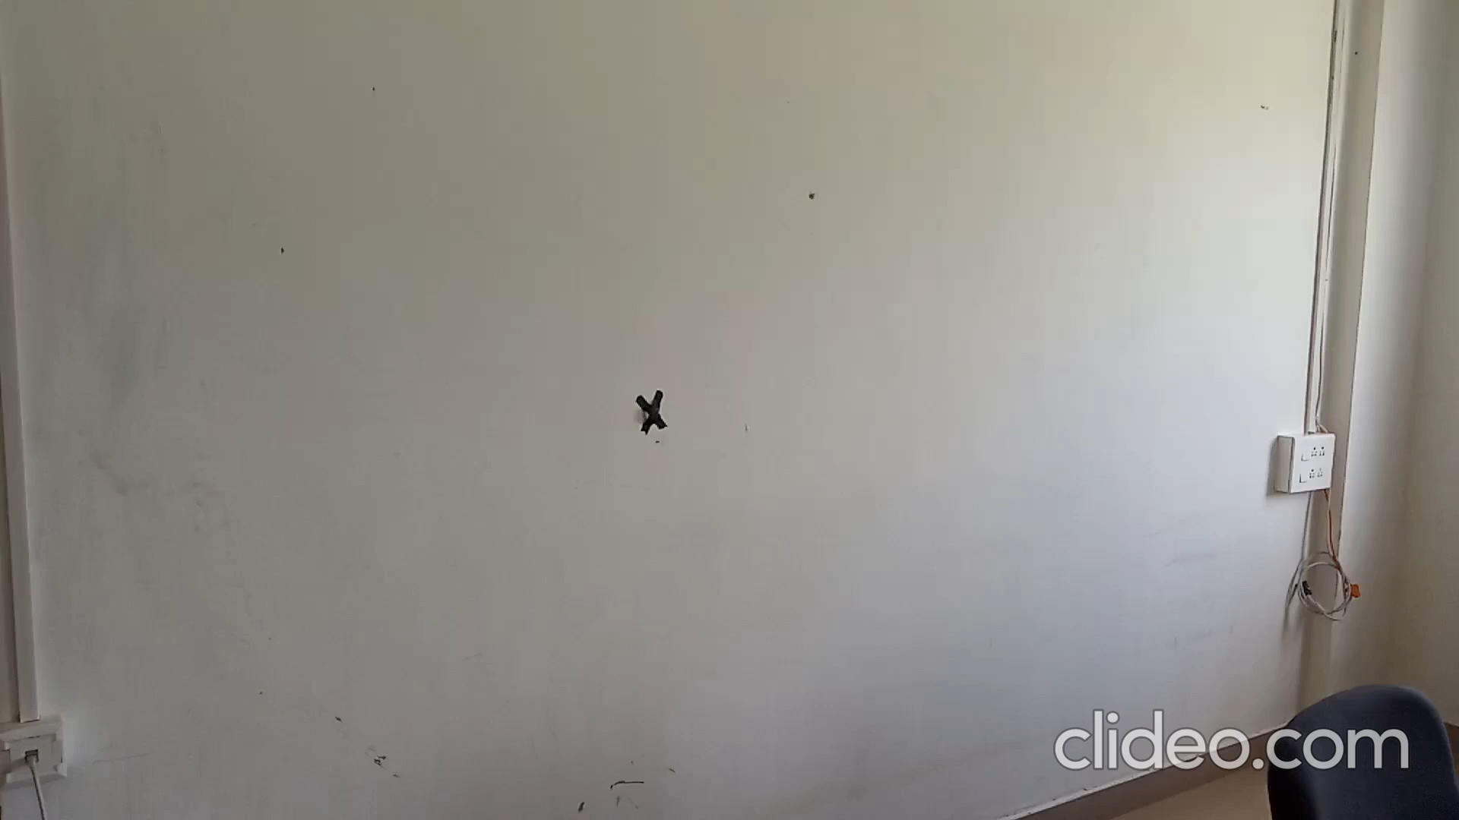
Demo Video

